Slide 1
Class 11 Classical Inference: Hypothesis Testing
Alison Presmanes Hill

Slide 2

Remember, statistics…
2 main reasons we love them:
Sometimes they are estimators for population parameters we care about
Sometimes they are test statistics, i.e. the basis for a hypothesis test

Slide 3
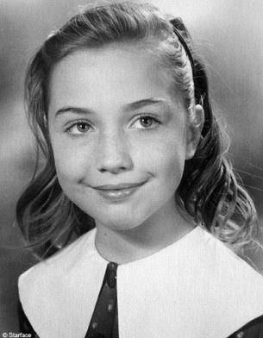
Aspiring astronauts
Inspired by Alan Shepard, the first American to journey into space, a 14-year-old Hillary Rodham from suburban Chicago wrote a letter to NASA in 1961 asking what she needed to do to become an astronaut.

Slide 4

Let’s pretend
Upon receipt of the letter in 1961, NASA decided to conduct a study to test whether girls who are aspiring astronauts in high school have “above average” IQ

Slide 5
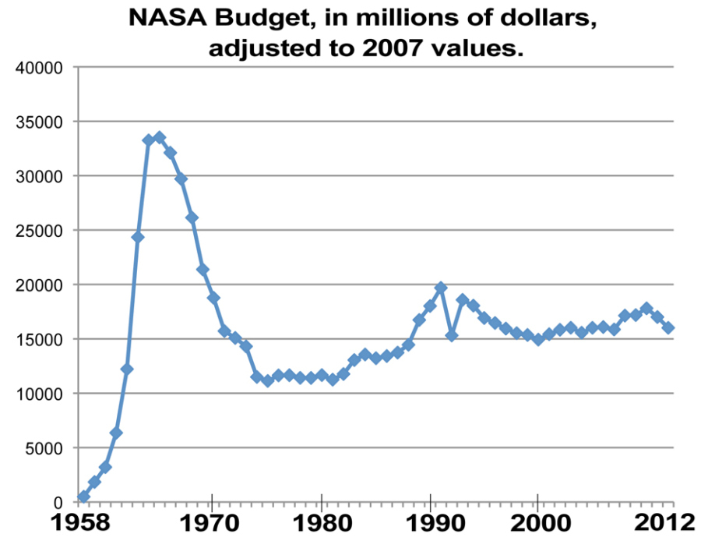
The (fictitious) study
Unfortunately, the NASA budget in 1961 was pretty low
So they studied only 25 high school girls, all of whom were aspiring astronauts (AA)
Population (normally distributed): µ = 100; 𝞼 = 15

Slide 6

A (non-directional) alternative hypothesis
H₀:
IQ scores for AA will not differ from population;
H₁:
IQ scores for AA will be different from population;
Two-tailed test

Slide 7

And the sample mean is…

Slide 8
One-sample z-test
For known:

Slide 9
One-sample z-test
For known:

Slide 10
From wikipedia…
The p-value is defined as the probability, under the assumption of the null hypothesis, of obtaining a result equal to or more extreme than what was actually observed.
Depending on how it is looked at, the "more extreme than what was actually observed" can mean
X ≥ x (right-tail event) or
X ≤ x (left-tail event) or
the "smaller" of X ≤ x and X ≥ x (double-tailed event).
Thus, the p-value is given by
Pr(X ≥ x|H) for right tail event,
Pr(X ≤ x|H) for left tail event,
2*min{Pr(X ≤ x|H),Pr(X ≥ x|H)} for double tail event.

Slide 11
http://math.stackexchange.com/questions/1493880/two-tailed-hypothesis-test-why-do-we-multiply-p-value-by-two

Slide 12
One-sample z-test
Does sample perform differently than general population (known: μ & σ)?
Now what?
Determine z_{critical} values for your α
Must “beat” ±1.64 for α = .10, 2-tailed, to reject null
Must “beat” ±1.96 for α = .05, 2-tailed, to reject null
Must “beat” ±2.32 for α = .01, 2-tailed, to reject null

Slide 13

Obtaining the p-value
One-tailed
pz_up <- 1 - pnorm(z)
Two-tailed
pz_2 <- 2*pz_up
c(pz_up, pz_2)
[1] 0.04779035 0.09558070

Slide 14
Obtaining the p-value
One-tailed
pz_up <- 1 - pnorm(z)
Two-tailed
pz_2 <- 2*pz_up
c(pz_up, pz_2)
[1] 0.04779035 0.09558070

Slide 15
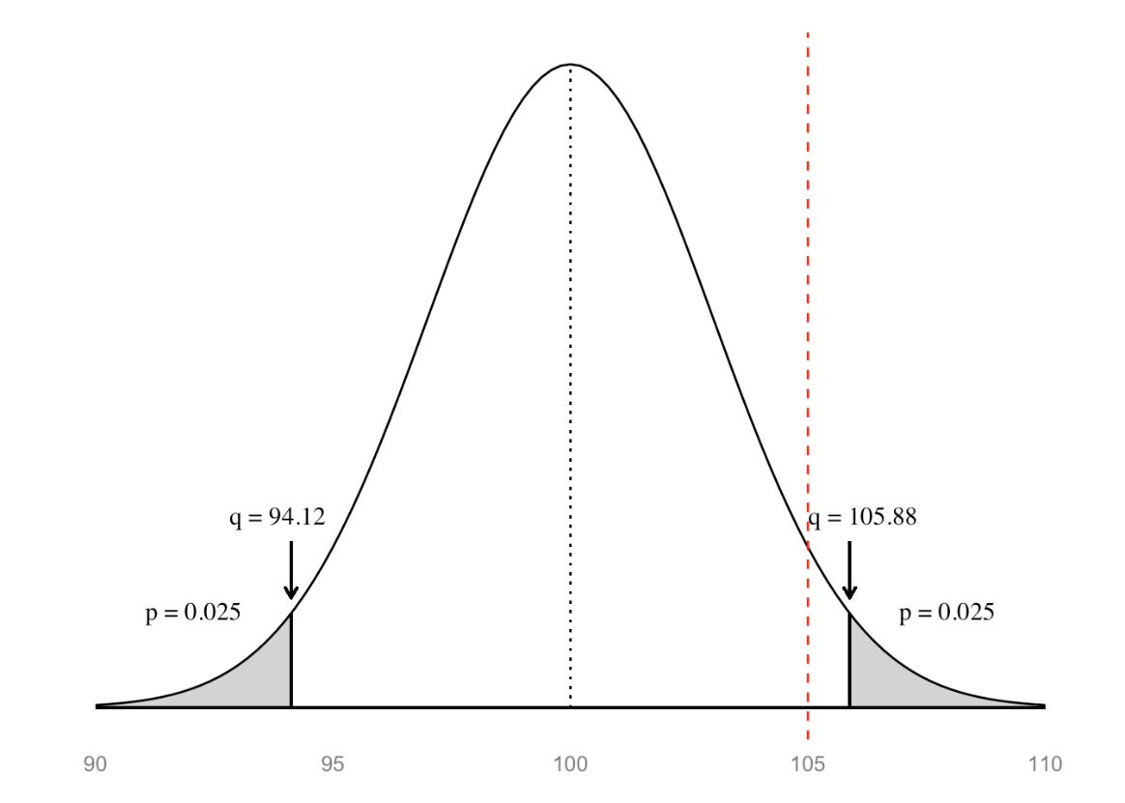
Two-tailed p-values more generally…
pz_1tail <- min(pnorm(z), 1 - pnorm(z))
pz_2tail <- 2 * pz_1tail
pz_2tail
[1] 0.0955807
→ p = .0955

Slide 16
When the null hypothesis is true
1-sample z-test
n = 25

Slide 17
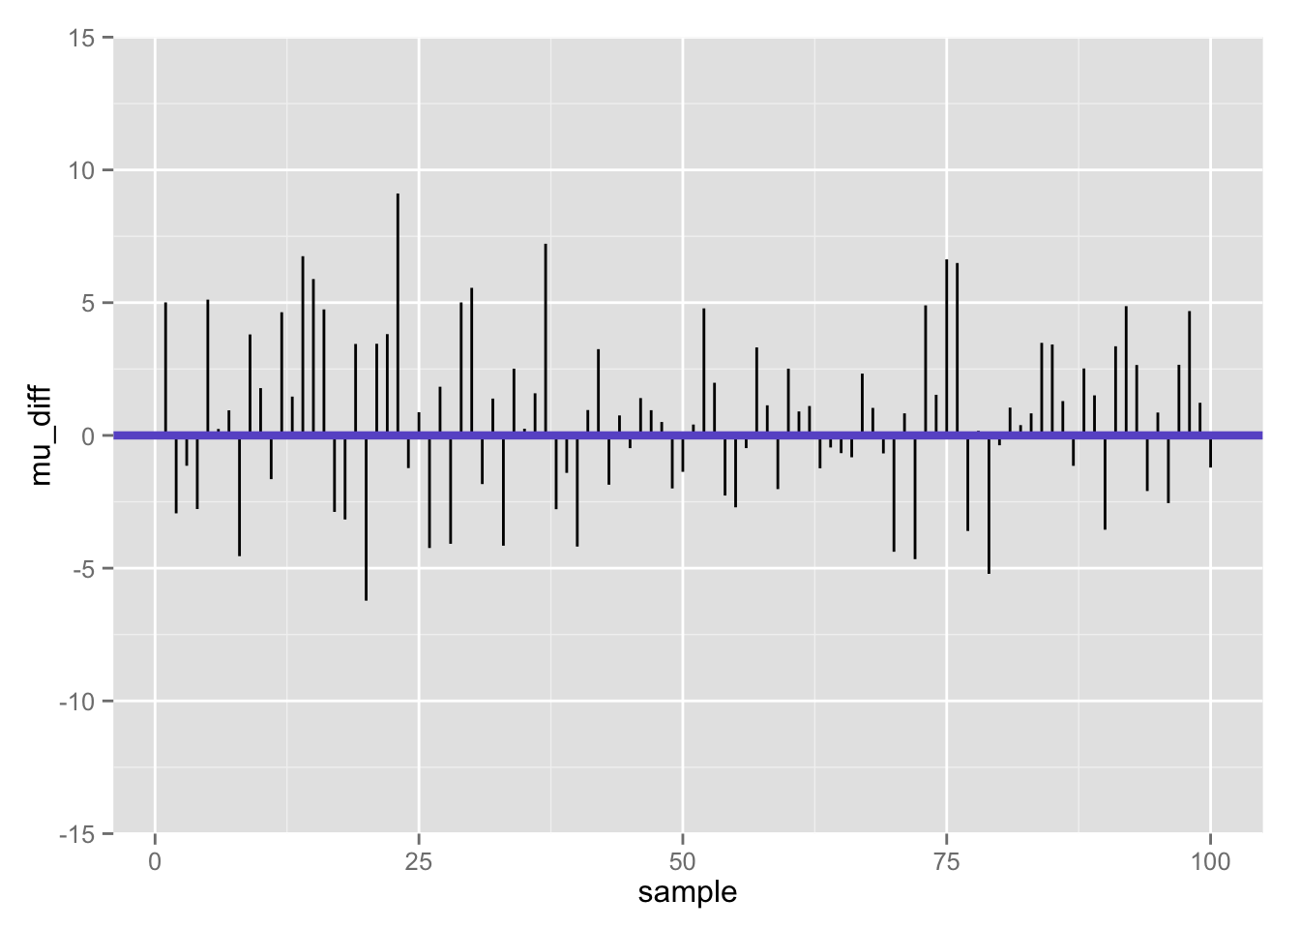
Differences between population mean and sample mean (100 samples) when null is true

Slide 18
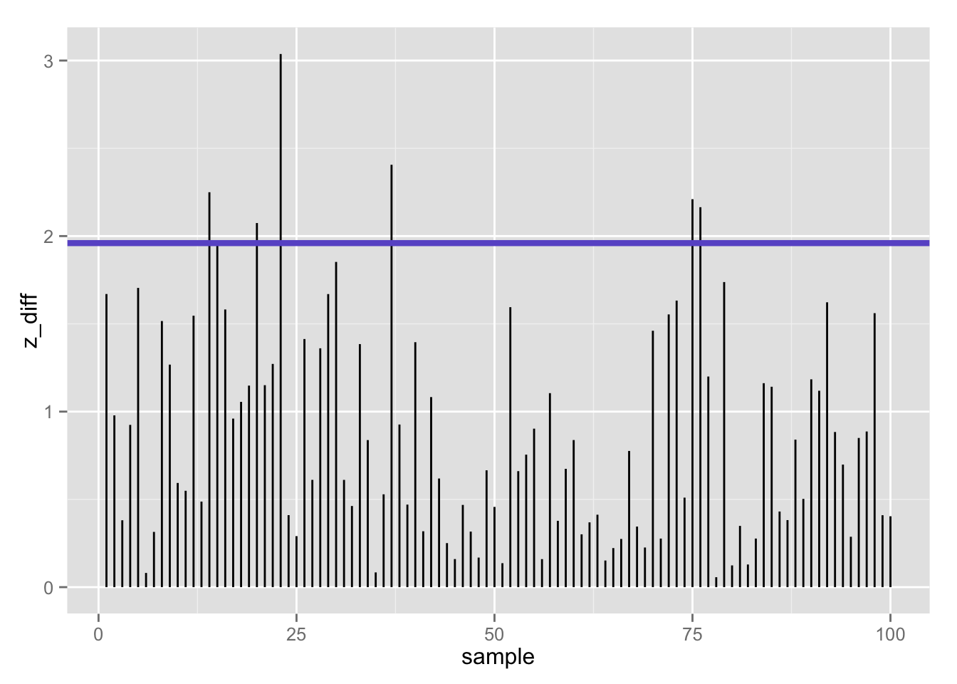
100 z-statistics (absolute value) when null is true: 7% false positives using z-test (𝛂 = .05/2)

Slide 19
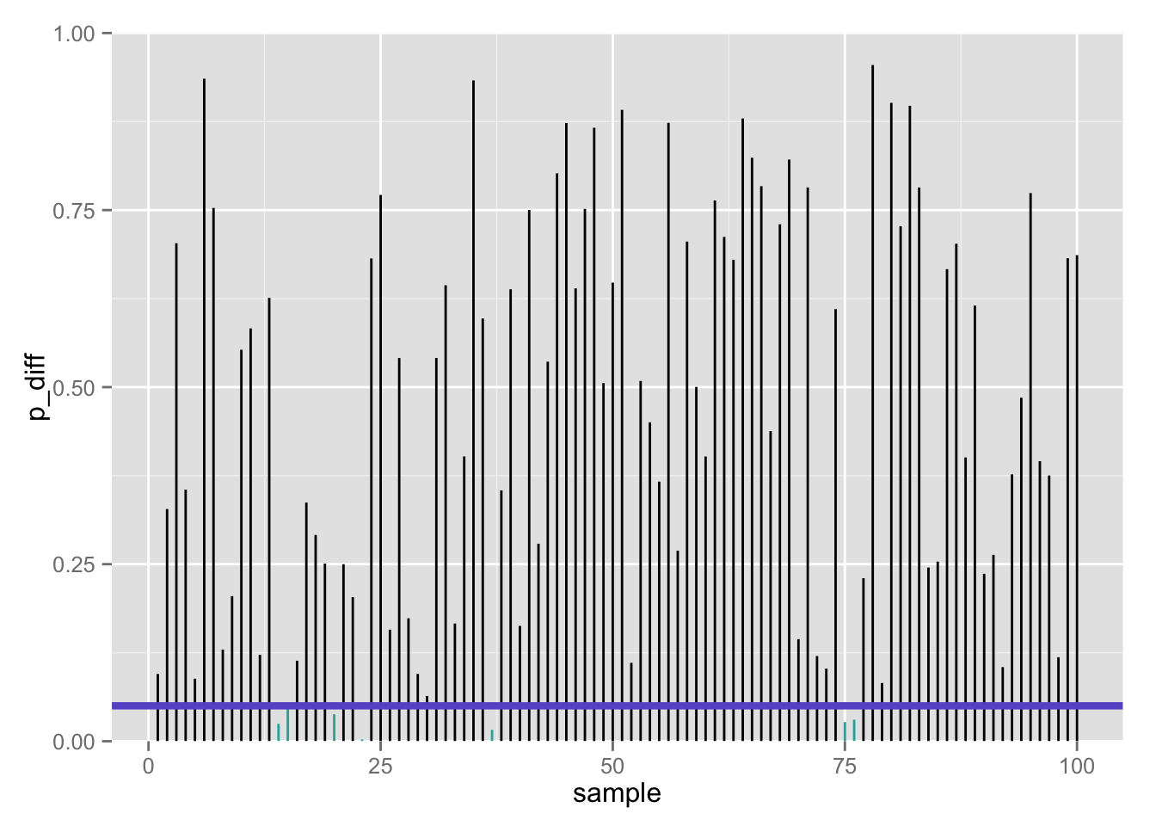
100 p-values when null is true: 7% false positives using z-test (𝛂 = .05/2)

Slide 20
Confusion matrix
 | Call based on observed data
True state of the world | Fail to reject H₀ | Reject H₀
H₀ | True negative 1 – 𝝰 | False positive Type I error 𝝰 | # true H₀’s
H₁ | False negative Type II error 𝛃 | True positive 1 – 𝛃 | # true H₁’s
 |  | # rejected H₀’s | # total tests
If the null is true…

Slide 21
Confusion matrix
 | Call based on observed data
True state of the world | Fail to reject H₀ | Reject H₀
H₀ | True negative 1 – 𝝰 | False positive Type I error 𝝰 | # true H₀’s
H₁ | False negative Type II error 𝛃 | True positive 1 – 𝛃 | # true H₁’s
 |  | # rejected H₀’s | # total tests
But… what if we are wrong??

Slide 22
“Statistics does not tell us
whether
we are right. It tell us the
chances
of being wrong.”
http://www.nature.com/nmeth/journal/v10/n9/full/nmeth.2613.html

Slide 23


Two ways we can be wrong…
Type 1 error (𝛂)
False positive
Type II error (𝛃)
False negative
“You’re not pregnant”
“You’re pregnant”

Slide 24
One way we can be wrong…
Type 1 error (𝛂)
False positive
Call: reject H₀
If we had rejected the null, it is of course possible that we should not have!
That is, the true state of the world may be H₀ (he’s not pregnant), but our sample data leads us to reject H₀ and (incorrectly) conclude that he’s pregnant
This is really embarrassing, so we control this: 𝛂 = ?
“You’re pregnant”

Slide 25
The other way we can be wrong…
Call: fail to reject H₀
Type II error (𝛃)
False negative
If we conclude that we cannot reject the null, it is of course possible that we should have!
That is, the true state of the world may be H₁ (she’s pregnant), but our sample data says we don’t have good enough evidence to reject H₀ (she’s not pregnant)
“You’re not pregnant”

Slide 26
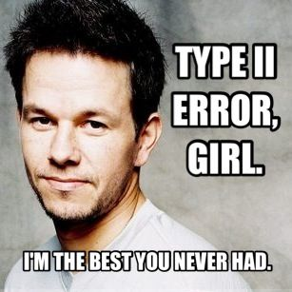
Type II errors
The one(s) that got away…

Slide 27







In our aspiring astronauts example…
Type 1 error (𝛂)
False positive
Type II error (𝛃)
False negative
Decide:
“You are smarter than average!”
Reality:
but you are actually not
Decide:
“You’re not smarter than average!”
Reality:
but you are actually

Slide 28
What if: the null hypothesis is FALSE?
1-sample z-test
n = 25

Slide 29
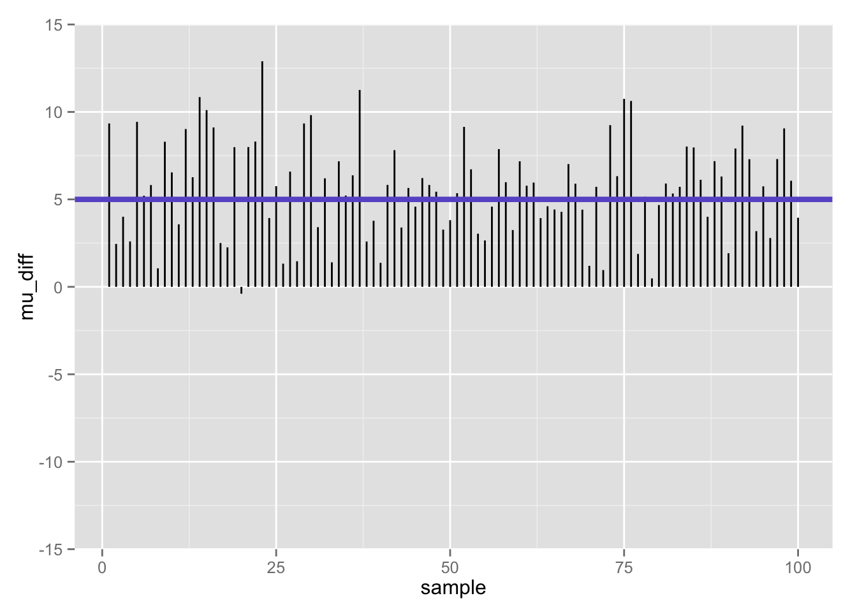

Slide 30
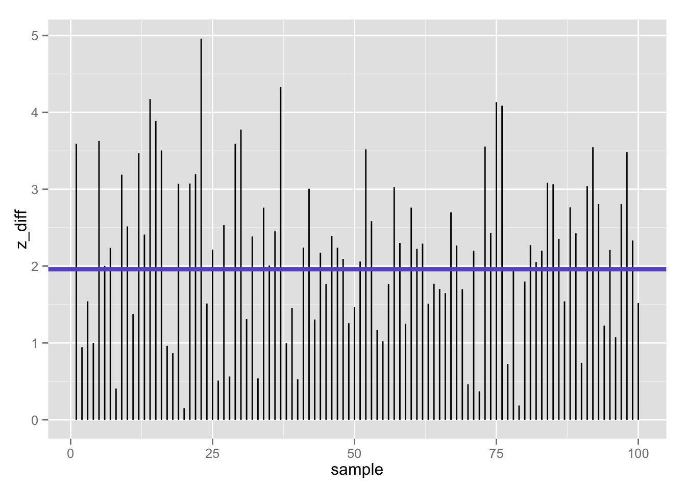
100 z-statistics (absolute value) when null is false: 39% false negatives using z-test (𝛂 = .05/2)
Flip side (1 −𝛃):
61% true positives

Slide 31
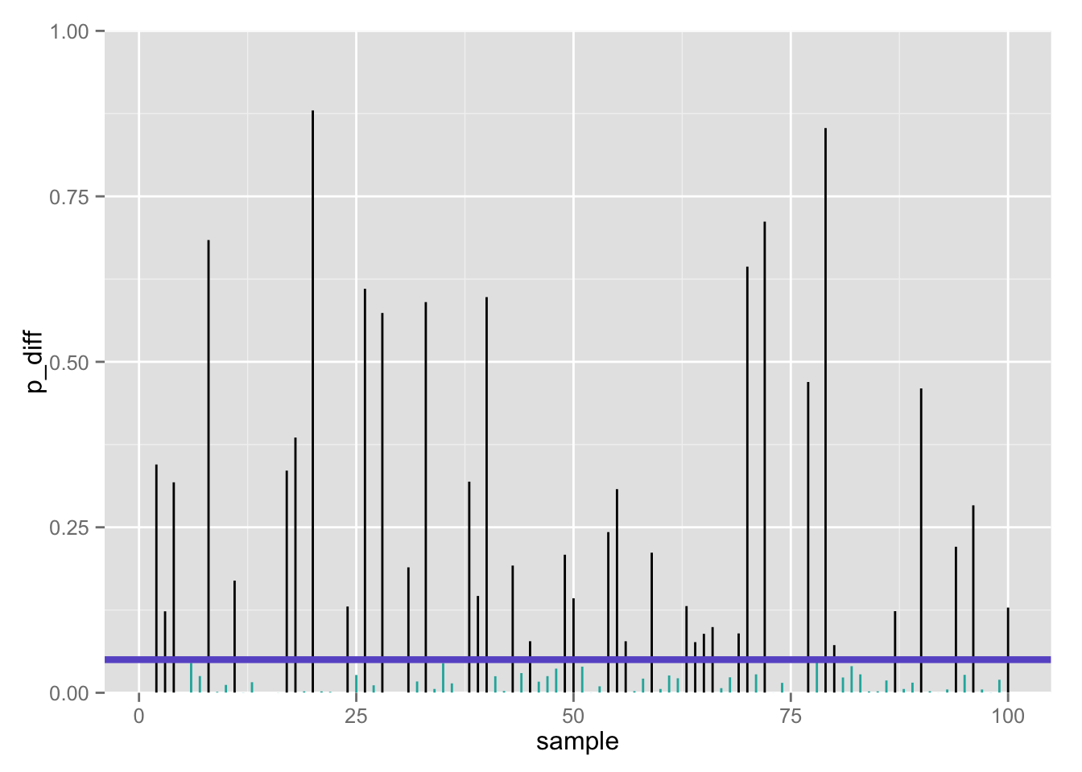
100 p-values when null is false: 39% false negatives using z-test (𝛂 = .05/2)
Flip side (1 −𝛃):
61% true positives

Slide 32
Now let’s vindicate our poor NASA interns: we have found the actual sample data, and now can calculate both the sample mean and standard deviation. We’ll use the sample standard deviation (s = 13) to estimate the population s.d. (𝞼).
What is the NULL distribution of this new test statistic?

Slide 33
Obtaining a test statistic
Remember our general formula for any test statistic about some parameter, θ:

Slide 34
One sample means T test

Slide 35
One-sample t-test

Slide 36
One-sample t-test

Slide 37
One-sample t-test
Does sample perform differently than general population (known: μ, unknown: σ)?
Now what?
Determine t_{critical} values for your α and df
Must “beat” that value to reject null

Slide 38
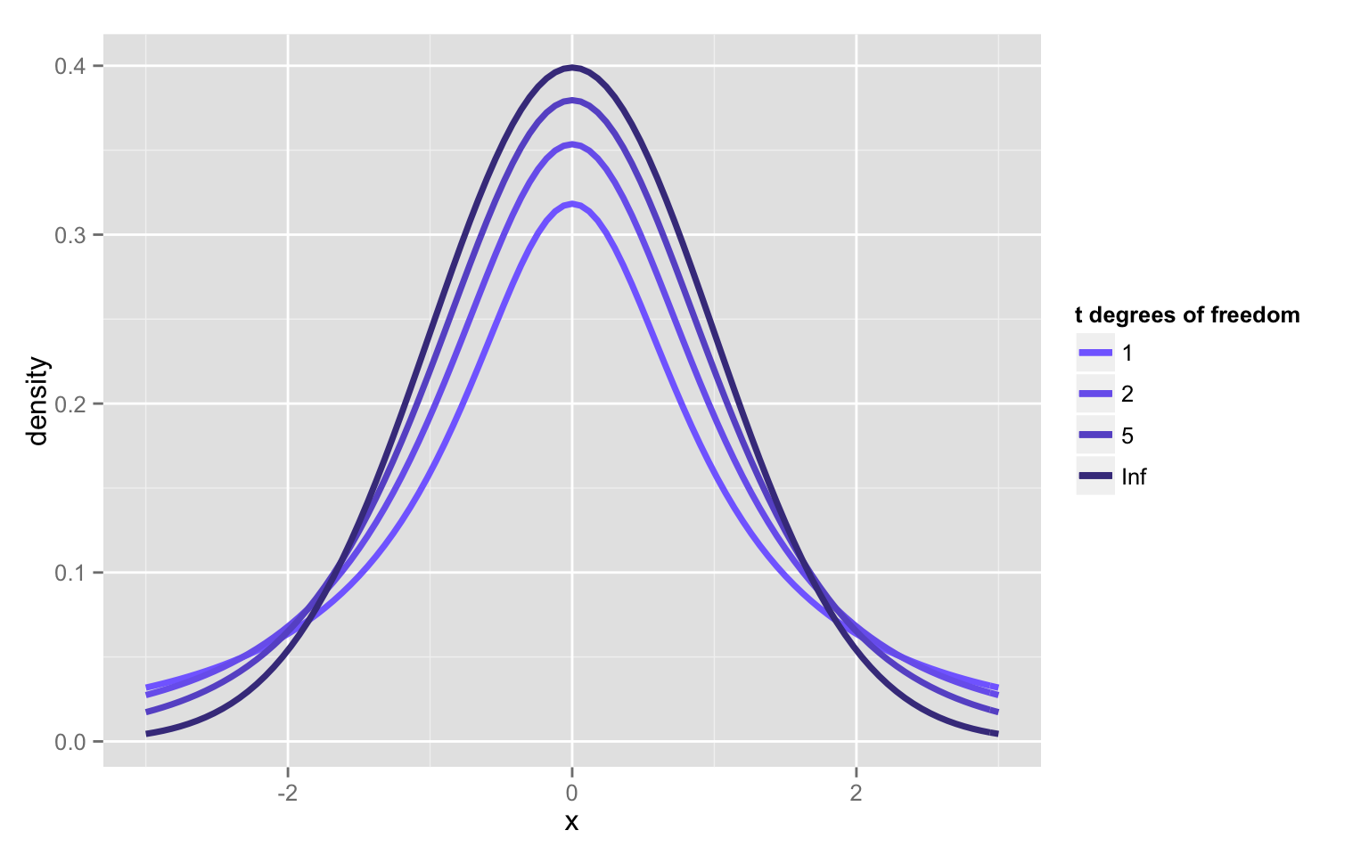
New distribution family: student’s t

Slide 39
The t-distributions: PDFs
Symmetric (skewness = 0)
Bell-shaped, but notice that the t always has always has relatively more AUC in the tails vs. the unit-normal, and unit-normal has relatively more scores in the center; thus t-distribution is leptokurtic
Kurtosis is undefined for t-variables with df < 4
On your own, at what N and df is the kurtosis of a t-variable = 3 (= to kurtosis of normal distribution)?

Slide 40
The t-distributions
Let T denote a random variable with a t-distribution with df degrees of freedom. Then:
E(T) = 0; same as unit-normal
Var(T) = df/(df-2); more spread out than unit-normal (↑ variance)
As df increases, the t- distributions converge to the unit normal.
t-distributions will be useful for statistical inference for one or more populations of quantitative variables.

Slide 41
Using the sample estimate of the variance
Recall the sample estimate of the population variance:
The t-statistic formula is:
At this point, you may be worried about the effect of variability of the variance estimate
You would be right: the random variable, t, is no longer normally distributed
It has a unique distribution: the t-distribution, with n-1 degrees of freedom
The t-distribution is asymptotically normal

Slide 42
Red = z, blue = t
n = 4 (×10,000 simulations)
n = 9 (×10,000 simulations)

Slide 43
Red = z, blue = t
n = 16 (×10,000 simulations)
n = 25 (×10,000 simulations)

Slide 45
Q-Q Plots of rt(100,df)
t with df=4
t with df=30

Slide 46
What is the p-value for the t statistic?
One-tailed, upper
pt_up <- 1 - pt(t, n – 1)
Two-tailed
pt_2 <- 2 * pt_up
c(pt_up, pt_2)
[1] 0.03320682 0.06641363

Slide 47
What is the p-value for the t statistic?
One-tailed, upper
pt_up <- 1 - pt(t, n – 1)
Two-tailed
pt_2 <- 2 * pt_up
c(pt_up, pt_2)
[1] 0.03320682 0.06641363

Slide 48
Two-tailed p-values more generally…
pt_1tail <- min(pt(t, n - 1), 1 - pt(t, n - 1))
pt_2tail <- 2*pt_1tail
pt_2tail
[1] 0.06641363

Slide 49
Family of t-tests
One-sample t-test for a single mean
Two-sample t-test (independent samples) for comparing 2 means
Two-sample t-test (correlated samples; dependent samples) for comparing 2 means with correlated or repeated measures

Slide 50
Interpreting significance in NHST
Non-significance ≠ true null hypothesis
Suppose we fail to reject the null because p > .05
We cannot assume then that null is true, but merely that we lack sufficient evidence to reject it
It is all too easy to find non-significant results by conducting…
A poor study…
With poor measures…
And low power.
Consider: “Not guilty” verdict in a jury trial- prosecutor may have failed to present a strong case
Not guilty ≠ innocent
If you truly want to support the null, look into equivalence testing/tests of close fit

Slide 51
Constructing a confidence interval for µ

Slide 52
Calculating 95% CI for µ in R, 𝞼 unknown
# sample statistics
xbar <- 105
s <- 13
n <- 25
# margin of error
me <- qt(.975, n - 1) * (s/sqrt(n)) # .975 --> .025 at EACH tail
# 95% confidence intervals
lowert <- xbar - me
uppert <- xbar + me
c(lowert, uppert)
[1] 99.63386 110.36614
Two-tailed CI
Is µ = 100 in there??

Slide 53
Calculating 95% CI for µ in R, 𝞼 unknown
# sample statistics
xbar <- 105
s <- 13
n <- 25
# margin of error
me <- qt(.975, n - 1) * (s/sqrt(n)) # .975 --> .025 at EACH tail
# 95% confidence intervals
lowert <- xbar - me
uppert <- xbar + me
c(lowert, uppert)
[1] 99.63386 110.36614
Two-tailed CI

Slide 54
One-sample t-test in R
Have to have actual data- not just sample statistics
So far, I have only been playing with sample statistics- I didn’t actually have sample data! Let’s make up some sample data with the sample mean/sd we need:
set.seed(1)
iq_aa <- seq(83.8, 126.2, length.out = 25)
mean(iq_aa) # perfect!
[1] 105
sd(iq_aa) # close enough!
[1] 13.00231

Slide 55
One-sample t-test in R
aat <- t.test(iq_aa, mu = 100) # Ho: mu = 100
aat
One Sample t-test
data: iq_aa
t = 1.9227, df = 24, p-value = 0.06646
alternative hypothesis: true mean is not equal to 100
95 percent confidence interval:
99.63291 110.36709
sample estimates:
mean of x
105
# Recall our previous 95% confidence interval- pretty close!
c(lowert, uppert)
[1] 99.63386 110.36614
Two-tailed test

Slide 56

Mansplain it to me…
devtools::install_github(c("hilaryparker/explainr", "hilaryparker/mansplainr"))
mansplain(aat)
That's great that you were able to do a hypothesis test. You got a p-value of 0.066459. That means it's not significant at alpha = .05, but that's OK. The important thing is that you tried.

Slide 57

Complain about it…
devtools::install_github(c("hilaryparker/explainr", "hilaryparker/complainr"))
complain(aat)
This hypothesis test had a p-value of 0.0664587.
That's if you can trust any frequentist method. You should really be doing a Bayesian analysis. Did you hear about that journal that banned p-values?

Slide 58
Rationale for one sample T test
We collect sample data and calculate a sample mean.
If this sample come from the population we think it came from, then we would expect the sample mean to be approximately equal to the population mean.
Although they may differ by chance, we would expect large differences between sample means to happen infrequently.
Under the null hypothesis, we assume no difference in means.
We compare the the sample mean to the population mean to see if the difference is more than we would expect to get by chance under the null hypothesis.

Slide 59
Rationale for one sample T test
At alpha=.05, we therefore seek evidence that there is only a 5% chance that the magnitude of the difference we observe is consistent with what we would expect based on chance alone.
Remember: The *p*-value does not tell you if the result was due to chance. It tells you whether the results are consistent with being due to chance. These two things are not the same.
We use the standard error as the gauge of variability of the sample mean. If it is small, we expect most samples to have very similar means. If it is large, then large differences in sample means are more likely.

Slide 60
Rationale for one sample T test
If the difference between the sample means is larger than we would expect based on the standard error, then we know that one of two things has happened:
We made a mistake (boo!). There is no difference between the population and our sample means fluctuate a lot. By chance, we have collected a sample that is atypical of the population we drew from. Here, the difference is a fluke and the null is true; we incorrectly reject the true null hypothesis and thus commit a Type I error.
We made a discovery (yay!). The sample comes from a different population, that may be typical of THAT population. Here, the difference is genuine, and we correctly reject the null hypothesis.

Slide 61
When the null hypothesis is true
1-sample t-test
n = 25

Slide 62
Differences between population mean and sample mean (100 samples) when null is true

Slide 63
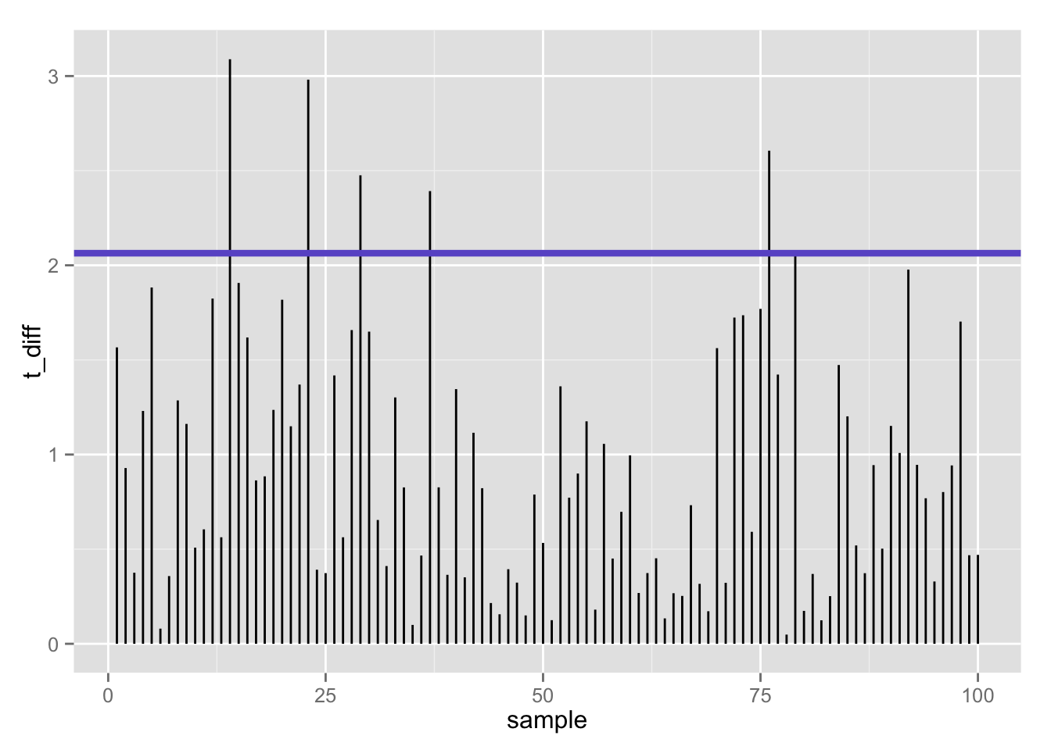
100 t-statistics (absolute value) when null is true: 5% false positives using t-test (𝛂 = .05/2)

Slide 64
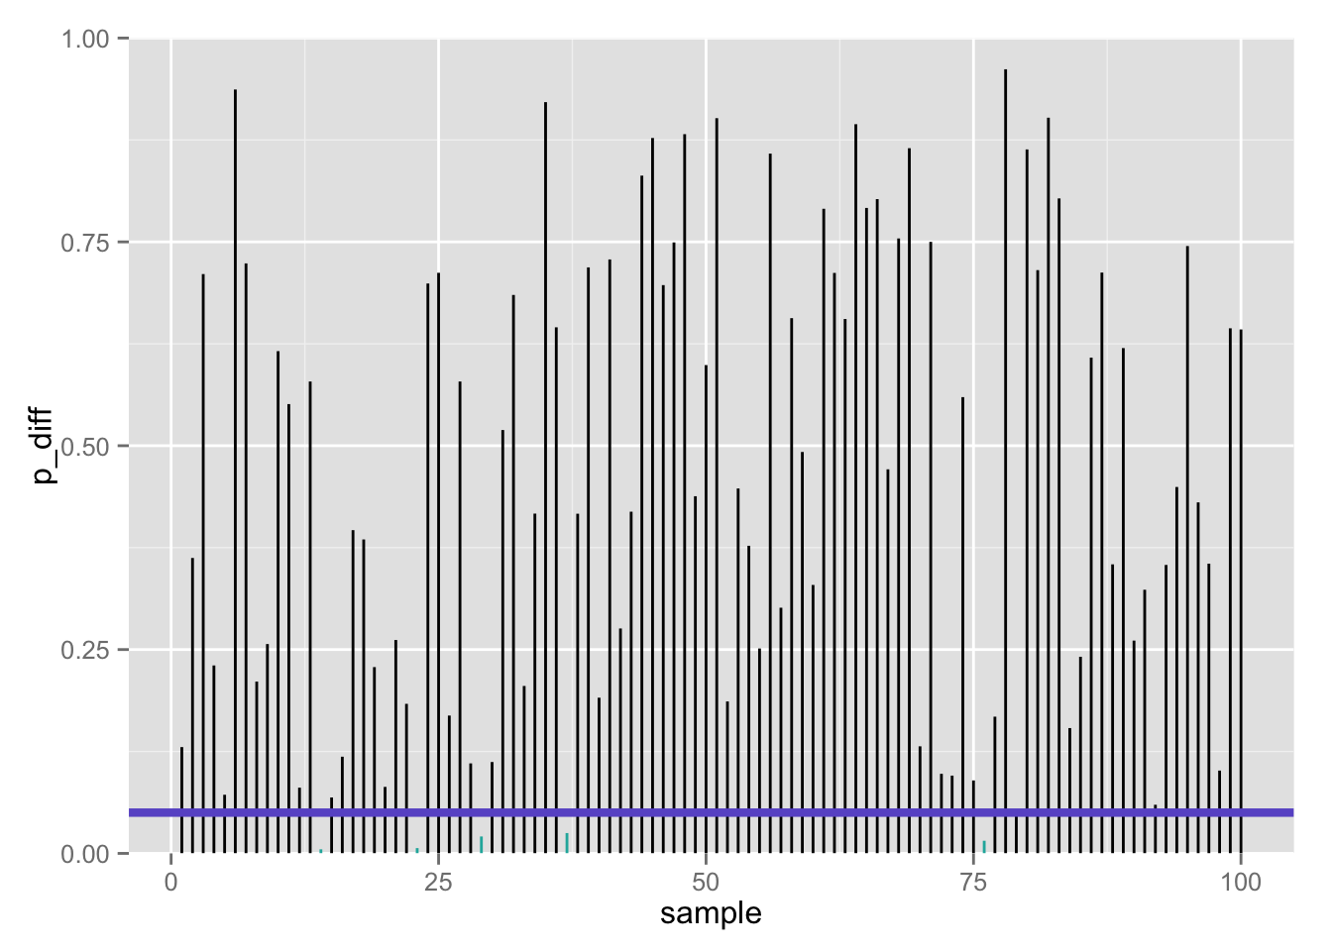
100 p-values when null is true: 5% false positives using t-test (𝛂 = .05/2)

Slide 65
What if: the null hypothesis is FALSE?
1-sample t-test
n = 25

Slide 66
Differences between population mean and sample mean (100 samples) when null is false

Slide 67
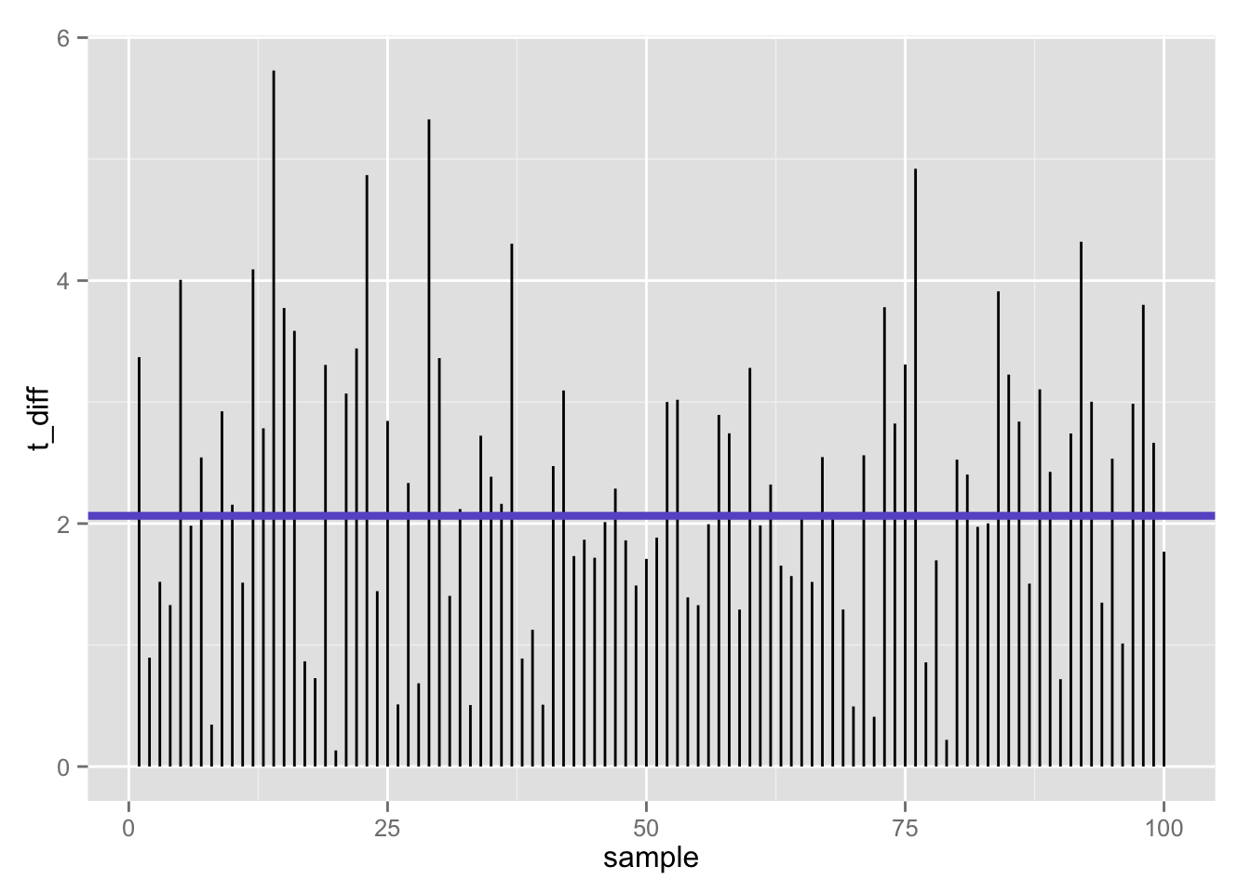
100 t-statistics (absolute value) when null is false: 47% false negatives using t-test (𝛂 = .05/2)
Flip side (1 −𝛃):
53% true positives

Slide 68
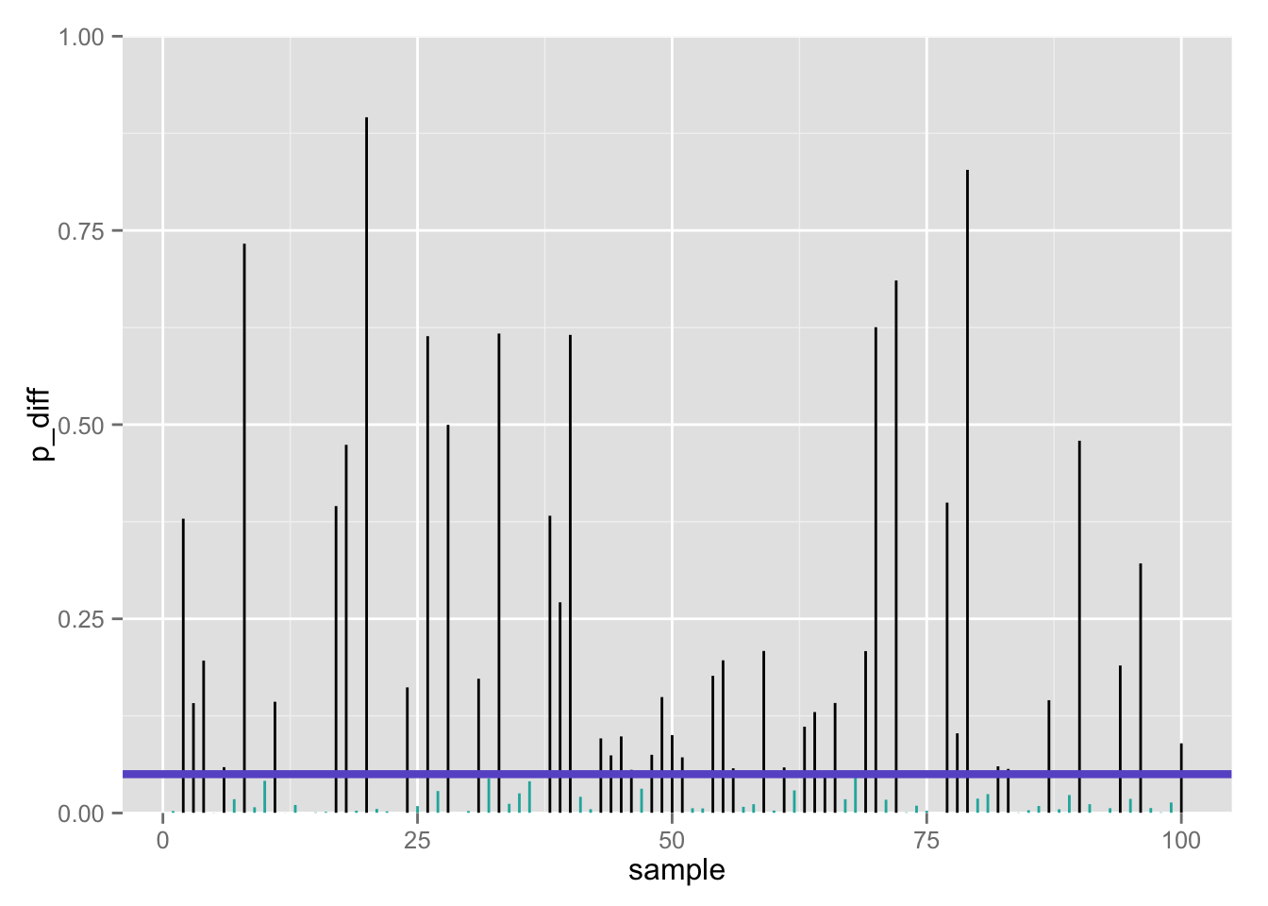
100 p-values when null is false: 47% false negatives using t-test (𝛂 = .05/2)
Flip side (1 −𝛃):
53% true positives

Slide 69

≈ 50% true positives seems low…
Only about half of our true effects would be detected in our study
Why?
Perhaps we lacked statistical power

